Slide 1
Speech Recognition APIs
A Brief and Incomplete Overview of Integrating Speech Recognition into Medicine

Slide 2
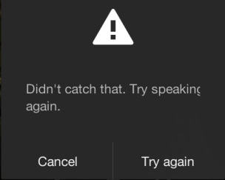
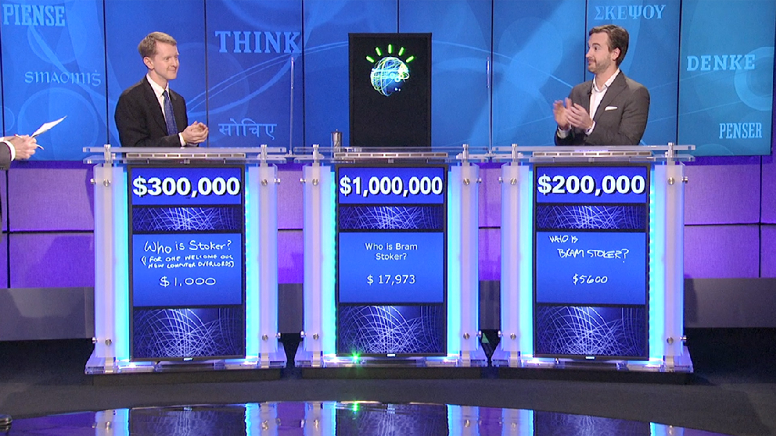
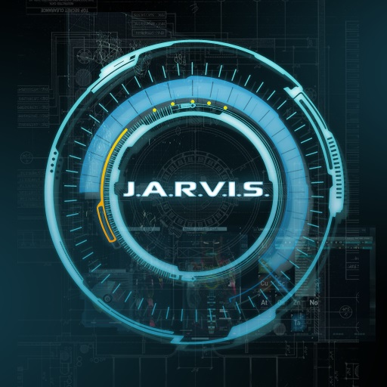

What is Speech Recognition

Slide 3
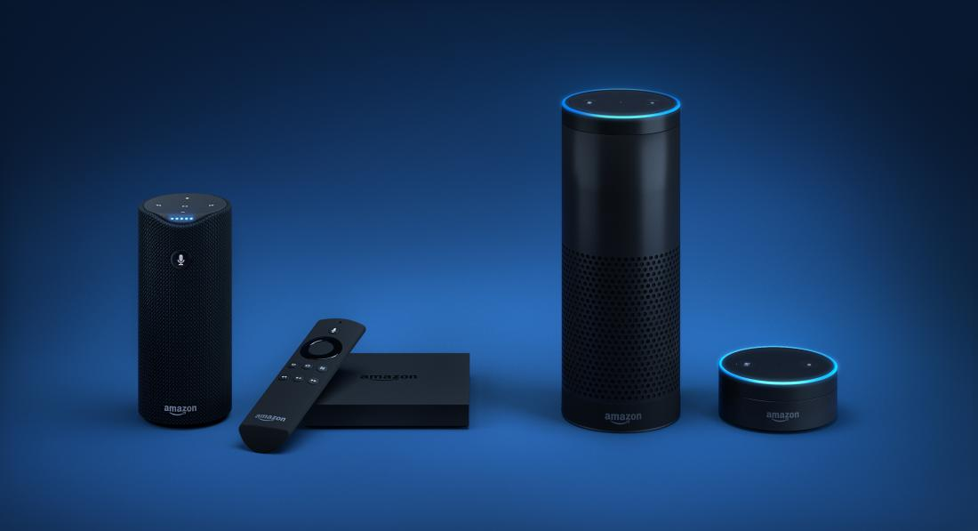
Alexa Skills Kit
Notes:
Alexa is an intelligent personal assistant which allows for users to interact with devices like Amazon Echo.
3rd party developers can create apps, called skills in the Alexa Skills Kit, which make use of text processed by Alexa .

Slide 4
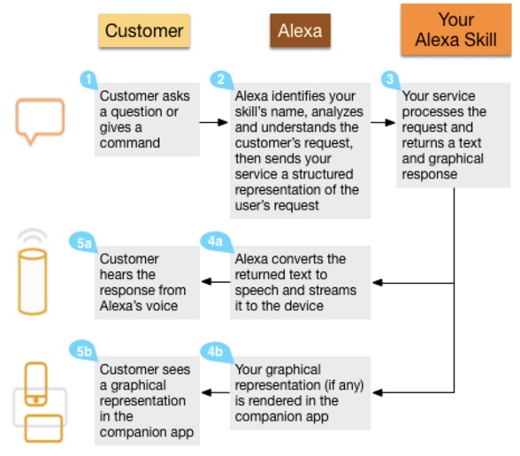
www.netguru.co/blog/voice-recognition-tools-review
Notes:
A user speaks, Alexa recognizes this audio, turns it into text, then sends your app an intent to perform an action.

Slide 5
Alexa Skills Kit
Amazon is investing in companies who are building skills for Alexa
Alexa Voice Service can be used on a multitude of devices
Only in English for now
I’m not sure if it’s being marketed for dictation services right now.

Slide 6
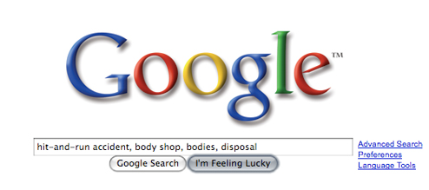
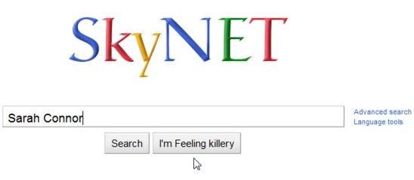
Google Cloud Speech API
Notes:
Google cloud platform is a cloud computing service which gives developers access to many different services that can be work together.
Google Cloud Speech API Uses NNs to transcribe dictation to interact with apps while being used. Basically gives your app access to the text version of the audio file.
Can be combined with other Google APIs like vision and Natural language processing

Slide 7
Google Cloud Speech API
Recognizes over 80 languages and variants
Works with anything that can send a REST or gRPC request
Developers can tweak the API by giving it a custom vocabulary
There doesn’t seem to be any direct access to the API

Slide 8
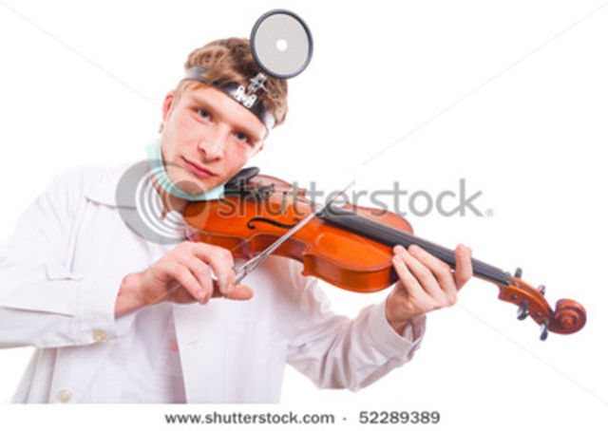
Nuance HealthCare Development Platform
Notes:
Usually I’d put up pictures that represent Nuance but there weren’t very many cool ones. Mostly just stock photos of doctors using technology.
Seems to have a lot of tools that we’d want to use in any mobile/computer app which would be used by healthcare professionals.

Slide 9
Nuance HealthCare Development Platform
Dragon Medical Speech Kit
Quickly embed voice technology in apps
20 different languages
Clinical Language Understanding SDK
Extract meaningful data from physician narratives
End-to-end security and HIPAA compliant

Slide 10
But what if we wanted to train our own system?

Slide 11
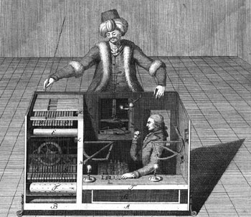
Amazon Mechanical Turk
Notes:
Excuse the cultural insensitivity, please.

Slide 12
Amazon Mechanical Turk
Allows Requesters to crowdsource Human Intelligence Tasks (HITs)
HITs are tasks which humans can do quickly, but computers cannot (for now)
Identify the best product description
Identify famous individuals in a photo
Read a piece of text.
Each HIT is worth a small monetary reward upon completion (average of $0.04)
Very large worldwide workforce to get a large number of results quickly.

Slide 13
Questions?

